Slide 1
ITEC 102 INTRODUCTION TO INFORMATION SYSTEMS
DANIEL OBUOBI, DCSIT, CU
REDESIGNING ORGANISATION WITH INFORMATION SYSTEMS

Slide 2
Unit Outline
Why build information systems?
Establishing organisation information requirements
Structural Organisational Change enabled by Information Technology
– Automation etc including BPR etc
The Systems development Process - SDLC
Approaches to Building Information Systems
Information System Projects – Success and failure

Slide 3
WHY BUILD INFORMATION SYSTEMS
Organizations incorporate technology for many reasons. The most obvious reason should be to save money through improved work processes and reduced manpower requirements, and to beat the competition
Some companies use Information Systems to help become more competitive. That is, they use the advantages of Information Systems to create new services, build better products more efficiently, or invent new products altogether.

Slide 4
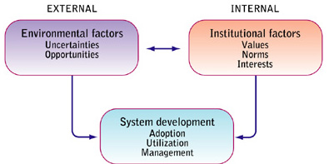
WHY BUILD INFORMATION SYSTEMS

Slide 5
How Information Systems Affect Organizations
The two major types of theories about how Information Systems affect organizations are
Economic theories and
Behavioral theories.

Slide 6
Economic Theories
It's sometimes cheaper to hire a computer than to hire a person. We may not like the idea that machines can replace human beings, but when you think about it, they have been doing this for thousands of years (microeconomic model).
Consider introduction a new policy in a company.
A proposed policy can be sent electronically to reviewers who will electronically collaborate on necessary changes.
By acknowledging receipt of the policy via email, the HR department knows everyone has received it.
The revised policy can be posted on the Intranet for all to see.

Slide 7
Why IS affects Org
IT is a factor of production that can be freely substituted for capital and labour. As the cost of IT falls it is substituted for labour, the rising cost.
From microeconomic theory, IT should result in a decline of the number of middle management.
IT helps firms to contract in size because it can reduce transaction cost and internal management cost including the cost of acquiring and analyzing information.
The transaction cost theory supports the idea that through technology, businesses can reduce the costs of processing transactions with the same zeal that they use to reduce production costs.

Slide 8
Behavioral Theories
Technology doesn't automatically transform organizations. There is no magic wand companies can wave and have all their problems solved just because they install the latest information system.
People using technology efficiently and effectively, however, can transform organizations. Communications up and down the organization and from one department to another on the same managerial level can be enhanced and increased by using technology.
Technology makes virtual organizations more feasible, cheaper, and easier to set up and tear down than before.

Slide 9
The Internet and Organizations
Business-to- business commerce is growing at a tremendous pace because of the cost savings the Internet allows. The Internet provides an open platform technology which allows transaction processing between businesses at much cheaper cost plus an easy-to-use interface. The innovative ways organizations are using the Internet, Intranets, and Extranets to improve their business processes are simply amazing.

Slide 10
Systems as Planned Organizational Change
The process of building a new information system is one kind of planned organizational change.
System builders must understand how a system will affect the organization as a whole.
They must consider how the nature of work groups will change and how much change is needed.
When specific projects have been selected within the overall context of a strategic plan for the organization and the systems area, an information systems plan can be developed.

Slide 11
IS and Corporate goals
The information systems plan must contain a statement of corporate goals and specify how general goals will be achieved by specific systems projects.
The strategy of moving from the status quo to the future is a critical feature of the information systems plan.
Managers must decide about hardware acquisition; telecommunications; centralization/decentralization of authority, data, and hardware; and required organizational change.
The implementation plan outlines the stages in development of the systems development plan.

Slide 12
Establishing an organization's essential information requirements
Enterprise analysis and critical success factors (CSFs) are two principal methodologies used for establishing an organization's essential information requirements.

Slide 13
Enterprise analysis
Enterprise analysis surveys managers about where they get information, how they use information, what their environment is like, what their objectives are, how they make decisions, and what their data needs are.
It provides a comprehensive view of the organization and of systems/data uses and gaps.
A fundamental weakness of enterprise analysis is that
  it produces an enormous amount of data that is expensive to collect and difficult to analyze.
  Also, since survey questions focus on what existing information is used,
  enterprise analysis tends to result in automation of current systems even when entirely new approaches are needed. [Figure 14-1]

Slide 14
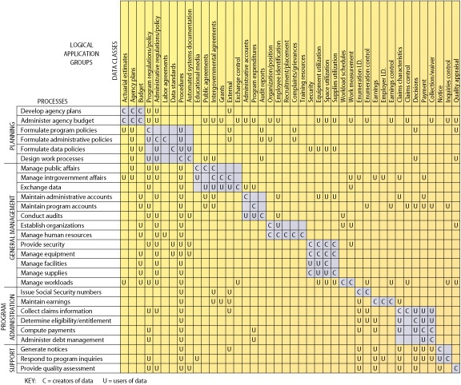
Process/data class matrix
FIGURE 14-1 Process/data class matrix
This chart depicts which data classes are required to support particular organizational processes and which processes are the creators and users of data.

Slide 15
The strategic analysis or CSF approach
The strategic analysis or CSF approach maintains that an organization's information requirements are determined by a small number of CSFs defined by managers.
A number of top managers are interviewed to determine their goals and the resulting CFSs.
These CFSs are aggregated to develop a picture of the firm's CSFs. Then systems are built to deliver information on these CSFs.
The CSF method is a focused approach rather than a broad inquiry. It is especially suitable for systems serving top managers and for the development of decision support systems (DSS) and executive support systems (ESS). The CSF method is clearly biased toward top managers. Additionally, this method does not necessarily overcome the impact of a changing environment or changes in managers. [Figure 14-2]

Slide 16
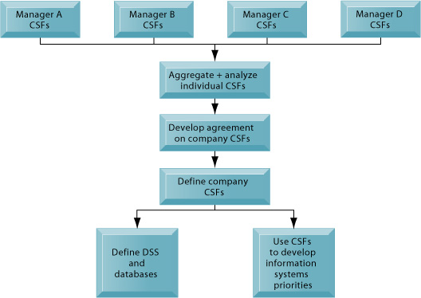
Using CSFs to develop systems
FIGURE 14-2 Using CSFs to develop systems
The CSF approach relies on interviews with key managers to identify their CSFs. Individual CSFs are aggregated to develop CSFs for the entire firm. Systems can then be built to deliver information on these CSFs.

Slide 17
Structural organizational change enabled by IT
Automation, rationalization, reengineering, and paradigm shifts are four kinds of structural organizational change which are enabled by information technology.
Automation: The most common form of IT-enabled organizational change is automation. Application of IT enables / allows employees to perform their tasks more efficiently and effectively. Eg. Payroll, airline reservation etc
Rationalization of procedures: is the streamlining of standard operation procedures, eliminating obvious bottlenecks, so that automation can make operating procedures more efficient. A deeper form of organizational change – one that follows quickly from early automation.
Business process reengineering, a more powerful type of organizational change, involves rethinking the flow of work and the business processes, with a mind to radically reduce business costs. Cut waste and eliminating repetitive, paper-intensive tasks.
A paradigm shift is a radical reconceptualization of the nature of the business and the nature of the organization.
Paradigm shifts and re-engineering often fail because extensive organizational change is difficult to orchestrate.
Some experts believe paradigm shifts will fail 70 percent of the time. But, the rewards of successful paradigm shifts can also be very high. [Figure 14-3]

Slide 18
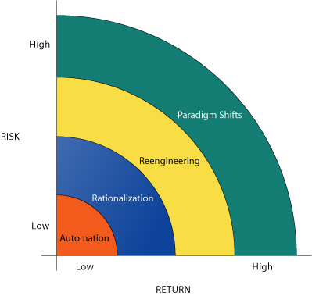
Organizational change carries risks and rewards
FIGURE 14-3 Organizational change carries risks and rewards
The most common forms of organizational change are automation and rationalization.
These relatively slow-moving and slowchanging strategies present modest returns but little risk.
Faster and more comprehensive change—such as reengineering and paradigm shifts—carries high rewards but offers substantial chances of failure.

Slide 19
More on Business Process Reengineering with example
Business process reengineering (BPR) involves radical restructuring of business processes before applying information technology to make them more efficient.
The mortgage industry has benefited from extensive reengineering of the mortgage application process to replace “desk-to-desk” sequential work on documents with a “work cell” approach in which many people work on the same document simultaneously. See below.
Reengineering sometimes uses workflow management software to move documents easily and efficiently between different users and locations. [Figure 14-4]

Slide 20
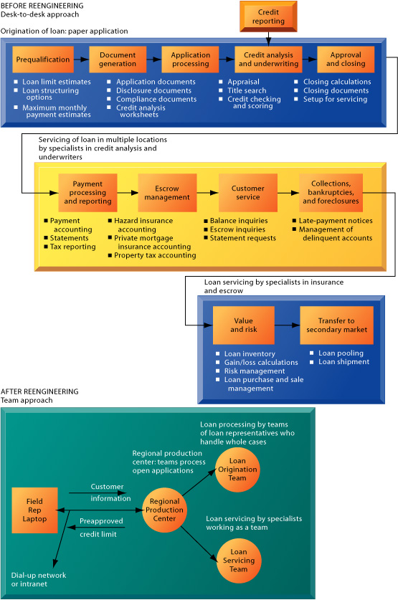
Redesigning mortgage processing in the United States
By redesigning their mortgage processing systems and the mortgage application process, mortgage banks will be able to reduce the costs of processing the average mortgage from $3,000 to $1,000 and reduce the time of approval from six weeks to one week or less. Some banks are even preapproving mortgages and locking interest rates on the same day the customer applies

Slide 21
Effective reengineering
Effective reengineering requires understanding which business processes need improvement and how this improvement helps the firm execute its strategy.
Management must understand and measure the performance of existing processes as a baseline.
Information technology creates new design options for various processes because it is used to challenge long-standing assumptions about work arrangements that used to inhibit organizations.
However, the majority of reengineering projects do not achieve breakthrough gains in business performance because the organizational changes are often very difficult to manage.

Slide 22
Business process management (BPM)
Business process management (BPM) provides a methodology and tools for dealing with the organization’s ongoing need to revise its numerous internal and interorganizational business processes.
BPM includes work flow management, business process modeling, quality management, change management, and tools for recasting the firm’s business processes into a standardized form where they can be continually manipulated.
Process-mapping tools are used to identify and document existing processes and to create models of improved processes that can then be translated into software systems.
BPM software tools automatically manage processes across the business, extract data from various sources and databases, and generate transactions in multiple related systems.
BPM also includes process monitoring and analytics to verify that process performance has been improved and measure the impact of process changes on key business performance indicators.

Slide 23
BPR vs BPM
Business process reengineering is primarily a one-time effort, focusing on identifying one or two strategic business processes that need change.
Business process management and quality improvement programs provide opportunities for more incremental business process change than business process reengineering.

Slide 24
Quality management
Quality management is another area of continuous process improvement.
Total quality management (TQM) is a concept that sees quality as a responsibility shared by everyone in the organization.
TQM focuses on making a series of continuous process improvements rather than dramatic bursts of change and is considered more incremental than business process reengineering. Six sigma is another quality concept, signifying a quality goal of 3.4 defects per millions of opportunities.
Benchmarking consists of setting strict standards for products, services, and other activities, and then measuring performance against those standards. Companies may use external industry standards, standards set by other companies, internally developed high standards, or some combination of the three.

Slide 25
Building Information Systems

Slide 26
Systems Development Life Cycle
Systems development refers to all the activities that go into producing an information systems solution to an organizational problem or opportunity.
Systems development is a structured kind of problem solving with distinct activities consisting of
systems analysis,
systems design,
programming,
testing,
conversion, and
production and maintenance. [See next slide]

Slide 27
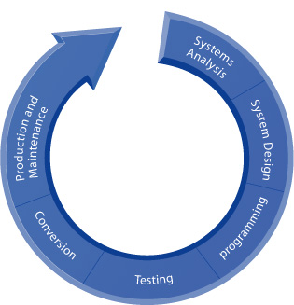
The systems development process
The systems development process
Building a system can be broken down into six core activities.

Slide 28
STAGES
END-PRODUCTS
Project Definition
Project proposal report
Systems study
System proposal report
Design
Design Specification
Programming
Program specification-code
Installation
System performance tests
Post-Implementation
Post-implementation audit
OPERATIONS
Milestone 1
Project
Initiation
Milestone 2
Design solution decision
Milestone 3
Design specification sign-off
Milestone 4
Production decision
Year 1
Year 2
3-8 Year Life Span
Figure 1: The Lifecycle methodology for systems development.

Slide 29
1. Systems analysis
Systems analysis involves defining the problem, identifying its causes, specifying the solution, and identifying the information requirements that must be met by a system solution.
System analysis also involves a feasibility study used to determine whether the proposed solution is achievable from a financial, technical, and organizational standpoint given the organization's resources and constraints.

Slide 30
System Analysis –feasibility study
Three major areas of feasibility must be addressed:
Technical feasibility: whether the proposed solution can be implemented with the available hardware, software, and technical resources.
Economic feasibility: whether the benefits of the proposed solution outweigh the costs.
Operational feasibility: whether the proposed solution is desirable within the existing managerial and organizational framework.

Slide 31
System Analysis- Requirements Analysis
Requirements analysis carefully defines the objectives of the new or modified system and develops a detailed description of the functions that the new system must perform
Requirements must consider economic, technical and time constraints, as well as the goals, procedures, and decision processes of the organization

Slide 32
The task on the systems analyst
One of the most challenging task of the systems analyst is to define the specific information requirements that must be met by the system solution selected.
Information requirements of a new system involve identifying who needs what information, where, when, and how.

Slide 33
2. Systems Design
The systems design is the overall plan or model that shows how the system will meet its information requirements.
Like a blueprint of a building or house, a system design consists of all the specifications that give the system its form and structure.
The design of an information system is the overall plan or model for that system
The design for information systems can be broken down into logical and physical design specifications
The system designer details the systems specifications that should address all of the managerial, organizational, and technical components of the system solution.
User information requirements drive the entire system building effort, so information system design often demands a very high level of end-user participation

Slide 34
Systems Design
Logical design lays out the components of the system and their relationship to each other as they would appear to users. It shows what the system solution will do as opposed to how it is actually implemented physically.
Physical design is the process of translating the abstract logical model into the specific technical design for the new system

Slide 35
Systems Design
The remaining steps in the systems development process translate the solution specification established during systems analysis and design into a fully operational information system
These concluding steps 3-6 consist of
  programming,
  testing,
  conversion, and
  production and maintenance.

Slide 36
4. Programming
The process of translating design specification into software for the computer constitutes a smaller portion of the systems development cycle than design and, perhaps, the testing activities.
During the programming stage, system specifications that were prepared during the design stage are translated into program code.

Slide 37
5. Testing
Thorough testing must be conducted to confirm that the system produces the right results.
Testing an information system involves three types of activities: unit or program testing, system testing, and acceptance testing.
Unit testing tests each program separately in the system.
  Although it is widely believed that the purpose of such testing is to guarantee that programs are error free, this goal is realistically impossible
System testing checks the information system as a whole to determine if it works as intended.
  It tries to determine if discrete modules will function together as planned and whether discrepancies exist between the way the system actually works and the way it was conceived.
Acceptance testing results in user and management final certification that the system is ready to be used in a production setting.
To ensure that all aspects of testing are as comprehensive as possible, the development team works with users to devise a systematic test plan. [Figure 14-6]
Systems tests are evaluated by users and technical staff and reviewed by management. When all parties are satisfied that the new system meets their standards, the system is formally accepted for installation.

Slide 38
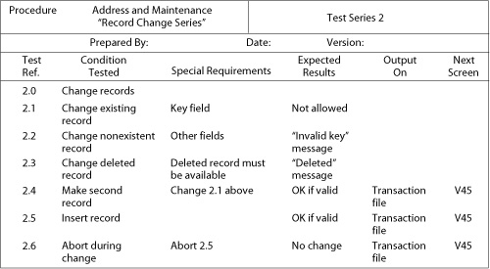
A sample test plan
FIGURE 14-6 A sample test plan to test a record change
When developing a test plan, it is imperative to include the various conditions to be tested, the requirements for each condition tested, and the expected results. Test plans require input from both end users and information systems specialists.

Slide 39
5. System Conversion
Conversion is the process of changing from the old system to the new one. It answers the question, “Will the new system work under real conditions?”
A parallel strategy calls for both the new and old systems to be run together until everyone is assured that the new system functions correctly.
The direct cutover strategy replaces the old system with the new one on a specific date.
The pilot study introduces the new system first to a limited area of the organization, and when the pilot version is working correctly it is, then installed throughout the rest of the organization.
The phased approach strategy introduces the new system in stages, either by functions or by organizational units.

Slide 40
Production & Maintenance (documentation)
Moving from an old system to a new one requires that end users be trained to use the new system.
Detailed documentation showing how the system works from both a technical and end-user standpoint is finalized during conversion time for use in training and everyday operations.
A formal conversion plan provides a schedule of all the activities required to install the new system.
The most time consuming activity is the conversion of data.
After the new system is installed and conversion is complete, the system is said to be in production.
Maintenance involves any further changes in hardware, software, documentation, or procedures to correct errors, meet new requirements, or improve processing efficiency.
Maintenance is significantly reduced through better system analysis and design practices.

Slide 41
Overview of the systems life cycle
The systems lifecycle—based on the premise that information systems have a life cycle similar to living things—is a traditional methodology for developing an information system.
The six stages of an information system's life cycle are project definition, systems study, design, programming, installation, and post-implementation.
Each stage consists of basic activities that must be performed before the next stage can begin.

Slide 42
life cycle methodology
The life cycle methodology has distinct stages and a formal division of labor.
Technical specialists are responsible for much of the systems analysis, design, and implementation work;
end users are limited to providing information requirements and reviewing the work of the technical staff.

Slide 43
life cycle methodology (cont.)
The production and maintenance stage is the final stage in which the system is used and evaluated while in production and is modified to make improvements or to meet new requirements.
End users and technical specialists conduct a formal postimplementation audit to determine how well the new system has met is original objectives.

Slide 44
Usefulness of SDLC
The systems life cycle approach is used for building large transaction processing systems (TPS) and management information systems (MIS) where requirements are highly structured and well-defined.
It is also useful for complex technical systems such as space launches, air traffic control, and refinery operations.

Slide 45
Limitation of SDLC
However, there are serious limitations to the lifecycle approach.
It is very resource intensive and can take years to achieve.
A system may be obsolete while it is still on the drawing board.
The life cycle methodology is also inflexible and therefore inhibits change.
In addition, the method is ill-suited to decision oriented or small desktop applications which require a more unstructured approach

Slide 46
Limitations of the SDLC
The systems lifecycle approach is costly, time-consuming, and inflexible. Volumes of new documents must be generated and steps repeated if requirements and specifications need to be revised
The lifecycle approach is inflexible and discourages change.
Because of the time and cost to repeat the sequence of lifecycle activities, the methodology encourages freezing of specifications early in the development process.

Slide 47
Limitations of the Lifecycle Approach
The lifecycle method is ill-suited to decision-oriented applications. Decision makers may need to experiment with concrete systems to clarify the kinds of decisions they wish to make
Some of the problems of the traditional systems lifecycle can be solved by alternative system-building approaches. These approaches include prototyping, application software packages, end-user development, and outsourcing.

Slide 48
Alternative Approaches of Building Information System
There are alternative methods for building an information system apart from the traditional system development life cycle. They include:
  prototyping,
  the use of application software packages,
  end-user development, and
  outsourcing.

Slide 49
1. Prototyping
Prototyping is the process of building an experimental system quickly and inexpensively for demonstration and evaluation so that end users can better define information requirements.
The prototype is a preliminary model that is refined until it meets end-user requirements.
The process of repeating the steps to build a system over and over again is called an iterative process.
Prototyping is more explicitly iterative than the conventional life cycle and it actively promotes system design changes.

Slide 50
prototyping
The four-step model of the prototyping process consists of the following:
  (1) identify the user's basic requirements;
  (2) develop a working prototype;
  (3) use the prototype, and
  (4) revise and enhance the prototype. [Figure 14-11]

Slide 51
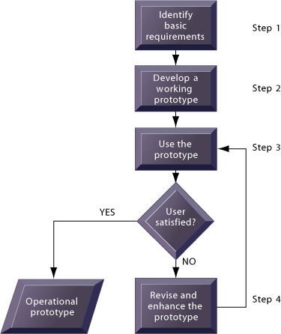
The prototyping process
FIGURE 14-11 The prototyping process
The process of developing a prototype can be broken down into four steps.
Because a prototype can be developed quickly and inexpensively, systems builders can go through several iterations, repeating steps 3 and 4, to refine and enhance the prototype before arriving at the final operational one.

Slide 52
Advantages of prototyping
Prototyping is most useful when some uncertainty exists about user requirements or a design solution.
It is especially valuable for the design of the end-user interface of an information system such as on-line screens and commands.
The intense end-user involvement in prototyping promises the elimination of excess development costs and design flaws that occur when requirements are not fully captured the first time around.
User satisfaction and morale are heightened because users are presented with an actual working system.

Slide 53
Limitations of prototyping
Applications that are oriented to simple data manipulation and records management are considered good candidates for prototyping, but systems based on batch processing or that rely on heavy calculations and complex procedural logic are generally unsuitable for prototyping.
Large systems must be subdivided so that prototypes can be built one part at a time. But subdividing a large system may be difficult without a thorough requirements analysis using the conventional approach.
Rapid prototyping can gloss over essential steps in systems development. If a prototype works reasonably well, management may fail to see the need for further refinement.
Hastily constructed systems may be difficult to maintain and their technical performance may be inefficient.
Proper testing may be shortchanged, and documentation may not be kept up to date because changes are so easily made.

Slide 54
2. Application software package
An application software package, another strategy in developing an information system, is a set of prewritten, precoded application software programs that are commercially available for sale or lease.
There are application software packages available for simple tasks and for complex mainframe systems.
Packages are likely to be chosen as a development strategy where functions, such as payroll systems, are common to many companies or where there are limited information systems resources for in-house development and when microcomputer applications are being developed for end users.

Slide 55
application software package
The use of software packages, along with vendor’s support staff and documentation reduces costly systems design work and maintenance and support costs.
Disadvantages of software packages may include a lack of sophistication, firm-specific features, or integration features.
However, some package software developers do provide some features for customization, which allow a package to be modified to meet unique requirements without destroying the integrity of the package software. [Figure 14-12]

Slide 56
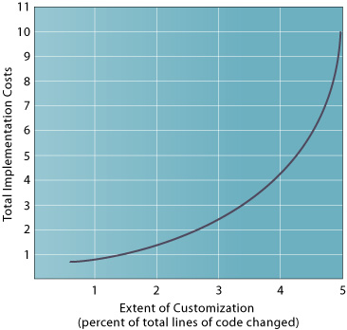
total implementation costs of customizing a software package
FIGURE 14-12 The effects on total implementation costs of customizing a software package
As the number of modifications to a software package rise, so does the cost of implementing the package. Savings promised by the package can be whittled away by excessive changes.

Slide 57
evaluating application software packages
The key criteria in evaluating application software packages are: functions; flexibility, user-friendliness, hardware, software resources, database requirements, installation and maintenance effort, documentation, vendor quality, and cost.
The package evaluation process is often based on a request for proposal (RFP), which is a detailed list of questions submitted to vendors of packaged software.
Responses to the RFP are compared to the system requirements and a package is selected.
Design activities focus on matching requirements to package features. Instead of tailoring the systems design specifications directly to user requirements, the design effort will consist of trying to mold user requirements to conform to the features of the package.

Slide 58
3. End-user development
In end-user development, software tools called fourth-generation languages enable end users to create reports or develop software applications with minimal or no technical assistance.
There are seven categories of fourth-generation languages:
  PC software tools,
  query languages,
  report generators,
  graphics languages,
  application generators,
  application software packages, and
  very high level programming languages.

Slide 59
Query languages
Query languages are software tools that provide immediate online answers to requests for information that are not predefined, such as “Who are the highest-performing sales representatives?”
Query languages are often tied to data management software and to database management systems.
On the whole, end-user-developed systems are completed more rapidly than those developed through the conventional systems life cycle.
However, fourth-generation tools still cannot replace conventional tools for some business applications because they cannot easily handle the processing of large numbers of transactions or applications with extensive procedural logic and updating requirements.
When systems are created rapidly, without a formal development methodology, testing and documentation may be inadequate.
Control over data can be lost in systems outside the traditional information systems department

Slide 60
4. Outsourcing
Outsourcing consists of using an external vendor to build or operate a firm’s information systems.
The system may be custom built or may use a software package. In either case, the work is done by the vendor rather than by the organization's internal information systems staff.
Outsourcing often saves application development costs or allows firms to develop applications without an internal information system staff, but it can also make firms lose control over their information systems and make them too dependent on external vendors.
Outsourcing is appropriate for applications that are not sources of competitive advantage or that require technical expertise not available in the firm.

Slide 61
Management Opportunities, Challenges, and Solutions
New information systems enable organizations to redesign their structure, scope, power relationships, work flows, products, and services.
In many instances, building a new system creates an opportunity to redefine how the organization conducts its business, leading to higher levels of productivity and performance.

Slide 62
Systems Scalability
Technologies and business conditions are changing so rapidly that agility and scalability have become critical success factors and primary goals of systems design.
With the ever greater demand for information systems, many businesses face development backlogs.
Systems must be scalable to accommodate growing numbers of users and to deliver data over multiple platforms.
To remain competitive, some firms feel pressured to design, develop, test, and deploy Internet or intranet applications in a matter of weeks or months.
Traditional development methods do not address the new features of Internet-based applications, which might have multiple tiers of clients and servers with different operating systems linked to transaction processing systems, as well as business processes that have to be coordinated with those of customers or suppliers.

Slide 63
Forging electronic relationships
Firms can no longer execute their business and system plans alone because they need to forge new electronic relationships with suppliers, distributors, and customers.
Systems building will therefore need to address more interorganizational processes and requirements than in the past.

Slide 64
Solutions
Solutions to the growing demands for information system development include using Object-oriented software tools, reusable software, prototyping, and fourth-generation language tools.
Rapid application development (RAD) includes the use of visual programming and other tools for building graphical user interfaces, iterative prototyping of key system elements, the automation of program code generation, and close teamwork among end users and information systems specialists.
Simple systems often are assembled from prebuilt components. The process does not have to be sequential, and key parts of development occur simultaneously.

Slide 65
Joint application design (JAD)
Joint application design (JAD) is used to accelerate the generation of information requirements and to develop the initial systems design.
JAD brings end users and information systems specialists together in an interactive session to discuss the system’s design.
In object-oriented development, groups of objects are assembled to provide software components for common functions such as online ordering capability.
This component-based development enables a system to be built by assembling and integrating existing software components.

Slide 66
Web services are used as tools
In addition to supporting internal and external integration of systems, Web services are used as tools for building new information system applications or enhancing existing systems.
Web services create software components that are deliverable over the Internet and provide new functions for an organization’s existing systems or create new systems that link an organization’s systems to those of other organizations.

Slide 67
INFORMATION SYSTEMS PROJECTS-SUCCESS AND FAILURE
When information systems fail to work properly or cost too much to develop, companies may not realize any benefit from their information system investment and the system may not be able to solve the problems for which it was intended. Because so many information systems are trouble-ridden, designer, builders and users of information system should understand how and why they succeed or fail.

Slide 68
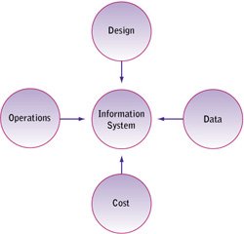
why information systems have such bad reputations.
The common thread running through all the horror stories and the problem areas are people, specifically users. Lack of user involvement and the failure to keep the user in the forefront of the development process is usually the cause of the system failure.

Slide 69
Information System Problem Areas
The actual design of the system fails to capture essential business requirements or improve organization performance. Information may not be provided quickly enough to be helpful; it may be in a format that is impossible to digest and use or it may represent the wrong pieces of data.
The data in the system have a high level of inaccuracy or inconsistency. The information in certain fields may be erroneous or ambiguous; or they may not be broken out properly for business purposes. Information required for a specific business function may be inaccessible because the data are incomplete.

Slide 70
Information System Problem Areas
Some systems operate quite smoothly, but their COST to implement and run on a production basis is way over budget.
The system does not run well. Information is not provided in a timely and efficient manner because the computer operations that handle information processing break down.

Slide 71
Measuring System Success
Various criteria have been developed, but the following measures of system success are considered the most important:
High levels of system use, as measured by polling users, employing questionnaires, or monitoring parameters such as the volume of on-line transaction.

Slide 72
Measuring System Success
User satisfaction with the system as measured by the questionnaires or interviews.
Favourable attitude of users about information system and information systems staff.
Achieved objectives, the extent to which the system meets its specified goals, as reflected improved organizational performance and decision making resulting from use of the system.
Financial payoff to the organization, either by reducing cost or by increasing sales or profit

Slide 73
Measures of Information System Success
Measures of information system success
High levels of system use
User satisfaction with system
Favourable attitudes about IS function
Achieved system objectives
Financial payoff
Figure 1: Measures of information system success.

Slide 74
Causes of Implementation Success and Failure
Implementation outcome can be largely determined by the following factors:
The role of users in the implementation process.
The degree of management support for the implementation effort.
The level of complexity and risk of the implementation project
The quality of management of the implementation process.
These are largely behavioural and organizational issues.

Slide 75
Causes of Implementation Success and Failure
User involvement in the design and operation of information systems has several positive results.
If an information systems project has the backing and commitment of management at various levels, it is more likely to be perceived positively by both users and technical information services staff.
Systems differ dramatically in their size, scope, level of complexity, and organizational and technical components.

Slide 76
Causes of Implementation Success and Failure
  The larger the project− as indicated by the amount spent, the size of the implementation staff, the time allocated to implementation, and the number of organizational units affected− the greater the risk.
  Some projects are more highly structured than others. Their requirements are clear and straightforward so the outputs and processes can be easily defined.

Slide 77
Managing Implementation
There are four basic project management techniques:
External integration tools link the work of the implementation team to that of user’s at all organisational levels.
Internal integration tools ensure that the implementation team operates as a cohesive unit.
Formal planning tools structure and sequence tasks, providing advance estimates of the time, money, and technical resources required to execute them.
Formal control tools help monitor the progress toward goals.

Slide 78
Overcoming User Resistance
Researchers have explained user resistance with one of three theories.
People-oriented theory: factors internal to users as individuals or as a group produce resistance. For instance, users may resist a new system or any change at all because they are fearful or do not wish to learn new ways of doing things.
System-oriented theory: Factors inherent in the design create user resistance to a system. For instance, users may resist a system because its interface is confusing and they have trouble learning how to make the system work.
Interaction theory: Resistance is caused by the interaction of people and systems factors. For instance, the system may be well designed and welcomed by some users but resisted by others who fear it will take away some of their power or stature in the organization or even their jobs.

Slide 79
Overcoming User Resistance
Strategies have been suggested to overcome each form of user resistance:
People oriented:
    User education (training)
    Coercion (edicts, policies)
    Persuasion
    User participation (to elicit commitment)

Slide 80
Overcoming User Resistance
System oriented:
    User education
    Improve human factors (user/system interface)
    User participation (for improved design)
    Package modification to conform to organization when appropriate
Interactions
    Solve organizational problems before introducing new systems
    Restructure incentives for users
    Restructure the user-designer relationship
    Promote user participation when appropriate

